Slide 1

Sustainable Forestry Initiative
West Virginia Training Module
Last Update 8/15/2024
Notes:
Introduce yourself, your company. Thank DOF for giving us some time to present today.

Slide 2
If something is sustainable, it means that…
It pollutes air and water.
You could keep doing it for a long time.
It's something from the environment that people use.
You have to stop doing it right now.
Notes:
Ask the question to the group? Right answer is “B”

Slide 3

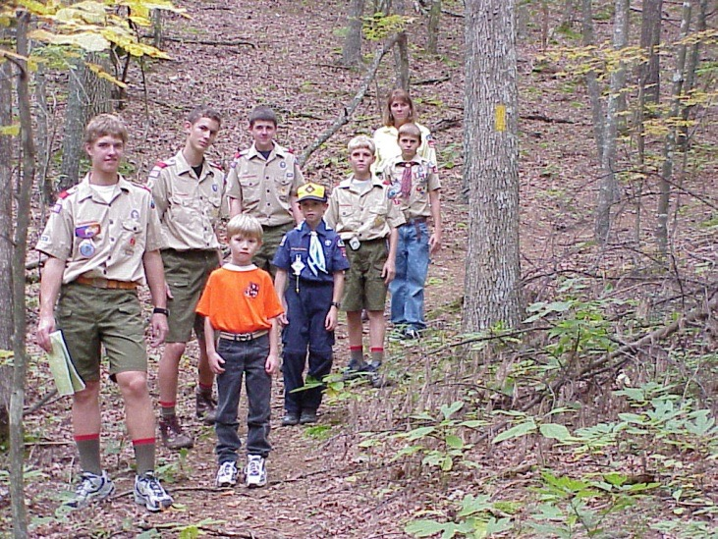
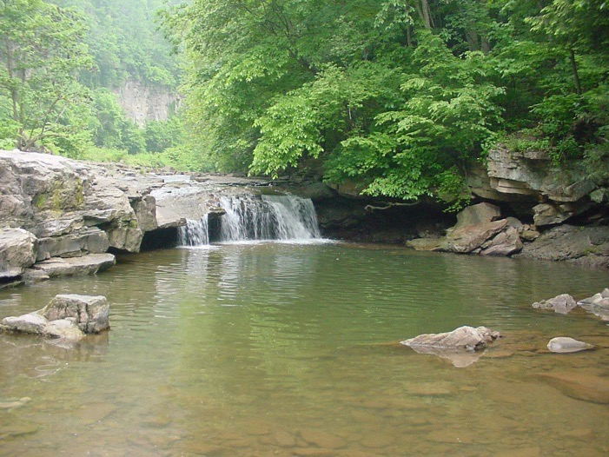
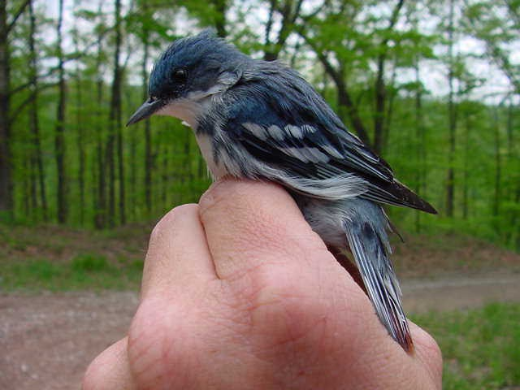
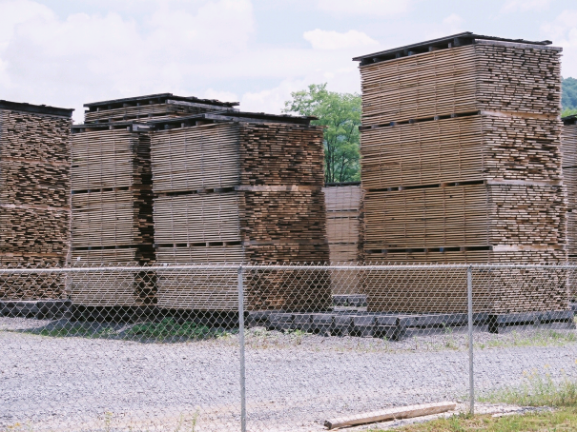
Sustainable Forestry
To meet today’s forest resource needs in a way that does not compromise the ability of future generations to meet their forest resource needs.
Notes:
Attendees need to know this definition of sustainable forestry (QUIZ).
SFI – It starts with a high standard and passes with an independent 3rd party audit
SFI Standard is based on principles and measures that promote sustainable forest management and considers all values

Slide 4
What is the SFI Program
Established in 1994 as an independent, non-profit organization dedicated to the future of our forests and promoting sustainable forest management.
Includes a comprehensive system of
  Principles
  Objectives
  Performance Measures
Developed by professional foresters, conservationists and scientists

Slide 5
How Big is SFI
Over 375 million acres of forestland in North America have been third-party audited to the SFI standard
  That’s more than double the size of the entire state of Texas!
SFI is one of the world's largest sustainable forestry programs

Slide 6

How SFI Works
SFI, Inc.
SFI State Implementation Committees (SIC)
Member Companies
SIC Supporters
Suppliers and Contractors
Notes:
But it’s NOT a pyramid scheme!

Slide 7







WV SFI Program Participants
Smurfit WestRock
Weyerhaeuser
Summit Bechtel Reserve - BSA
Conservation Fund
Pixelle Specialty Solutions
Lyme Mountaineer Timberlands
Landmark Forestry
Colane Corporation

Slide 8
SFI Influences Logger Training
Member Companies are audited to ensure that they are meeting the principles, standards, and performance measures.
Performance Measure 13.2.
Certified Organizations shall work to foster improvement in the professionalism of wood producers specific to qualified logging professionals.
Notes:
To maintain a current forest management, fiber sourcing, and/or chain-of-custody certificate, certified organizations must undergo a full recertification audit every five years.

Slide 9
WV DOF’s and SFI Training Requirements
WV Certified Loggers are required to have 2 credits of BMP training and 4 additional professional development credits.
DOF training are supplemented by SFI trainings to help meet the 4 additional professional development credits.
SFI requires loggers to have the DOF BMP credits as well as training that covers several other indicators.
Today’s training meets the requirements for both the DOF and SFI.

Slide 10

Four Pillars of SFI
Standards
Conservation
Community
Education
VISION: A world that values and benefits from sustainably managed forests.
MISSION: To advance sustainability through forest-focused collaboration.

Slide 11

SFI 2022 Standards and Rules
Reviewed and updated every 5 years – Last updated in 2022
Reflect SFI’s leadership in offering solutions to some of the world’s most pressing sustainability challenges.
Notes:
SFI has been in existence for almost 30 years

Slide 12
SFI And Certification
Notes:
There is a lot of talk in our industry about certification and the different standards. Today I would like to give you a brief introduction to SFI and to the different types of certification. You may hear someone say I am certified, your first question should be to what standard.
This is one reason we are here today. A certified company must help to promote logger training.

Slide 13






How many have heard of Forest Certification?
Do you know of any other Certification Programs?
Electronics – UL, Wi-Fi, Bluetooth, EnergyStar
Good Housekeeping
Food – Organic / Marine Stewardship Council
Accounting - CPA

Slide 14

SFI Product Labeling

Slide 15
SFI’s Four Standards
SFI now has four standards to support responsible forestry and procurement at each point in the supply chain:
  2022 Forest Management Standard *
  2022 Fiber Sourcing Standard
  2022 Chain-of-Custody Standard *
  2022 Certified Sourcing Standard
* Important Logging Indicators
Notes:
The SFI Standards are revised and updated every five years.
We established four stand-alone standards for the SFI 2022 Standards and Rules -- whole document is 212 pages long!
This means that no matter where you sit in the supply chain, SFI has a relevant standard to support responsible forestry.
Whether you’re concerned or engaged with forest management, fiber sourcing, or chain-of-custody, SFI works for you.

Slide 16
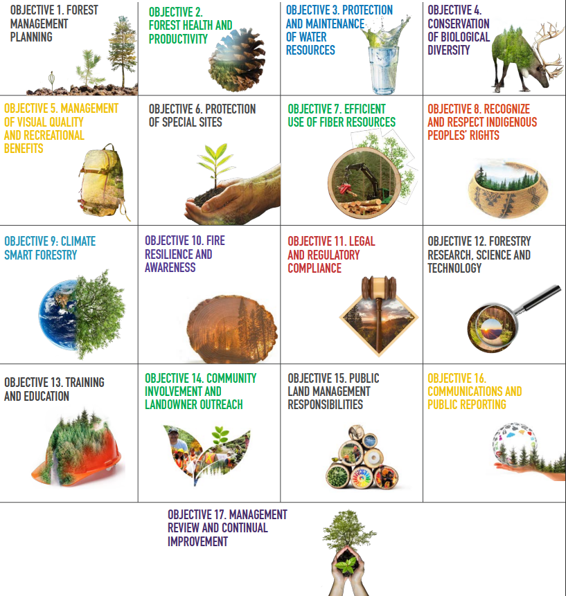
2022 Forest Management Standard
Program or monitoring system to ensure efficient utilization
Loggers who are aware of their responsibility as professionals are better equipped to protect the environment
Two logger training indicators
  Core training needed to attain qualified logging professional status.
  Continuing education needed to maintain qualified logging professional status.
Notes:
Over 375 million acres in the U.S. and Canada are certified to the SFI Forest Management Standard.
Tens of millions more are impacted by Fiber Sourcing – a proactive approach that rewards good forestry practices on non-certified lands.

Slide 17

2022 Chain-of-Custody Standard
An accounting system that tracks forest fiber content through production and manufacturing to the end product.
Tracks the percentage of fiber from certified forests, certified sourcing and recycled content.
Notes:
Chain of custody certification takes wood from a Forest Management Certified Forest and tracks it through the manufacturing process and allows the manufacturer to label the final product as certified.

Slide 18
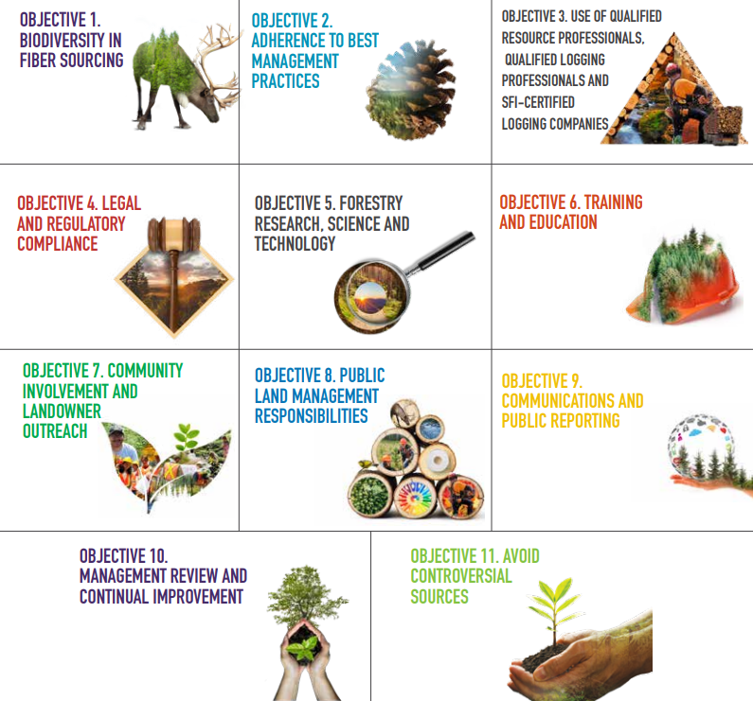
2022 Fiber Sourcing Standard
Sets mandatory practice requirements for responsible procurement of all fiber whether forest is certified or not.
The standard holds the individual mills accountable for promoting responsible forestry.
Requires the promotion and use of qualified logging professionals

Slide 19
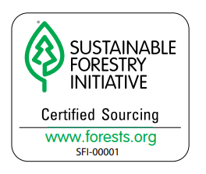
2022 Certified Sourcing Standard
Standards for primary and secondary producers sourcing SFI Certified Sourcing inputs to make an SFI Certified Sourcing claim.
No specific rules or indicators related to Logging.

Slide 20
Logger Training Indicators
In the new standards, there were SIX updated indicators related to logger training
The West Virginia SIC provides training to help each member company meet these indicators

Slide 21
Indicator 1:
“Awareness of sustainable forestry principles and SFI’s work across four pillars: standards, conservation, community, and education​.”

Slide 22

Awareness of Sustainable Forestry Principles
Mostly covered in previous slides.
SFI also leads efforts in education and community engagement
  Project Learning Tree – award-winning environmental education program designed for teachers and other educators, parents, and community leaders working with youth from preschool through grade 12.
  Community Grants - support collaborative projects between local communities and the SFI network to increase understanding of the values and benefits provided by sustainably managed forests.

Slide 23
Indicator 2:
“BMPs, including streamside management and road construction, maintenance, and retirement.”
Fully covered by the WV DOF BMP Training

Slide 24
Indicator 3:
“Awareness of responsibilities under the U.S. Endangered Species Act, Forests with Exceptional Conservation Value, and other measures to protect biodiversity and wildlife habitat.”

Slide 25
Endangered Species Act (ESA)
The federal Endangered Species Act of 1973 included provisions through which the US Fish and Wildlife Service can designate species as “Threatened” or “Endangered” due to critically low populations.
Includes plants, animals and aquatic species.
The ESA makes it illegal to “kill, harm, harass, posses, or remove a protected species from the wild”.
Penalties for violating this law include fines up to $200,000 for an organization and $100,000 for an individual and/or one year in jail.
Notes:
In West Virginia, there are both Threatened and Endangered (T&E) Species to be aware of. T&E species in WV include plants, animals and aquatic species.

Slide 26
Threatened species
A species which is likely to become an endangered species within the foreseeable future throughout all or a significant portion of its range if measures are not taken to improve their status.
As of 2022….
West Virginia is a permanent home to seven federally threatened species (5 animals, 2 plants).
Notes:
The bald eagle was once considered an endangered species. It’s populations have grown to the point that it was downgraded to “threatened”.

Slide 27
Endangered Species
Endangered species – one which is in danger of extinction throughout all or a significant portion of its range
West Virginia is a permanent home to 22 federally endangered species (17 animals, 4 plants)
In WV these can be found at:
  https://wvdnr.gov/plants-animals/rare-threatened-endangered-species/
Notes:
These web sites are the best location to find out what species are listed in WV.

Slide 28
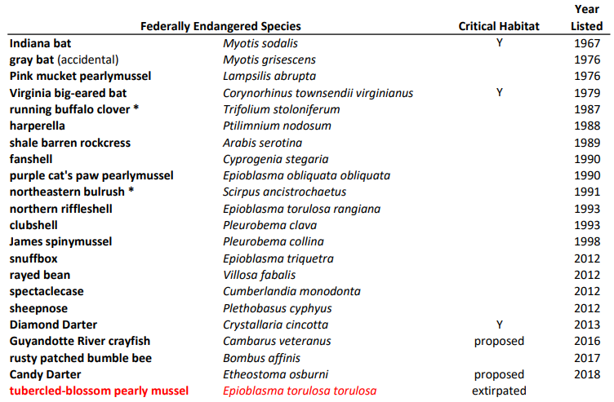
Notes:
Revised: 30 September 2020
listed species cheat sheet.xlsx (wvdnr.gov)

Slide 29
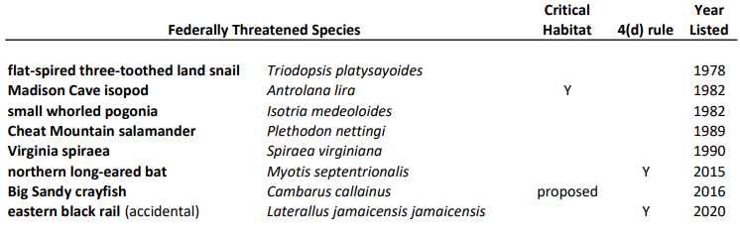

Slide 30
G1 Critically Imperiled & G2 Imperiled Species
NatureServe – Non-profit that provides scientific knowledge that supports informed decisions.
NatureServe assigns a “Global Rank”
WV has 66 - G1 and 67 - G2 Species
Some species and communities classified as G1 or G2 are rarer than species protected under the ESA.
No laws that limit activities involving G1 and G2 species
Important to conserve these species for future generations.
Full list at natureserve.com
Notes:
Critically imperiled - Plant or animal or community, often referred to as G1, that is globally extremely rare or, because of some factor(s), especially vulnerable to extinction. In West Virginia, examples include the Red Pine/Minniebush/Appalachian Rockcap Fern Forest, Ammon’s tortula, and West Virginia Spring Salamander.
Imperiled - Plant or animal or community, often referred to as G2, that is globally rare or, because of some factor, is very vulnerable to extinction or elimination. In West
Virginia, examples include the Red Spruce/Great Rhododendron Forest, Swordleaf phlox, and Elk River Crayfish.

Slide 31
Habitats
Most at-risk species reside in a unique habitat. As you consider potential harvesting sites, note any unusual habitats or features.
If you see anything unusual contact the WV DNR at 304-637-0245 for additional information.
Notes:
WV does not have a good system to check a location for threatened or endangered species. The best thing is to call this number in Elkins, WV to find out. You may have to send a map or GPS coordinates.
I know this is a little difficult but it is worth the trouble if you are purchasing timber. You need to know what you are purchasing or what you are cutting. Don’t be afraid of the process, finding an issue after the fact is much more trouble.

Slide 32
How to Incorporate G1 & G2 Conservation into Forest Management Activites
Always, appropriately implement the “WV Silvicultural Best Management Practices for Controlling Soil Erosion and Sedimentation from Logging Operations”.
Visit the online mapping tool https://wvfa.org/g1-g2-species/ to identify forest types in a county of interest.
The WVDNR has prepared reports for each forest type that includes a description of the forest type and the detailed list of G1 and G2 species and habitats that could be found in those forests.
Where you are working in a forest type with known or suspected G1 or G2 presence, appropriately implement the “General Conservation Recommendations” and/or “Special Recommendations”.

Slide 33
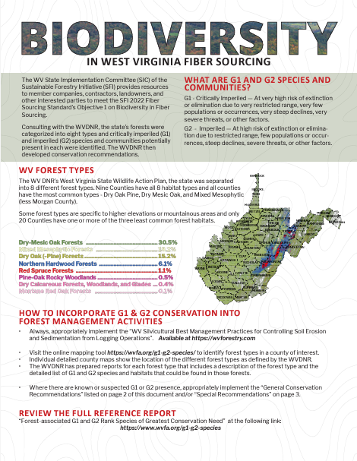
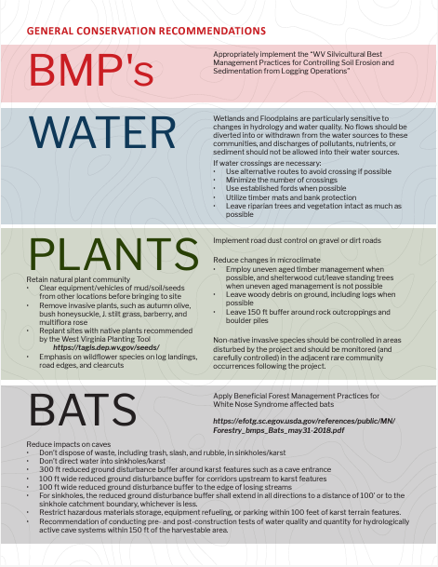
Printable WV Handout at WVFA.ORG/SFI

Slide 34
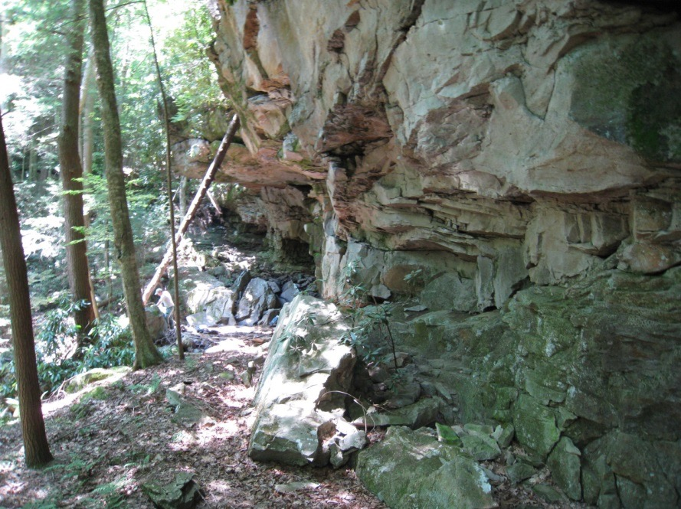
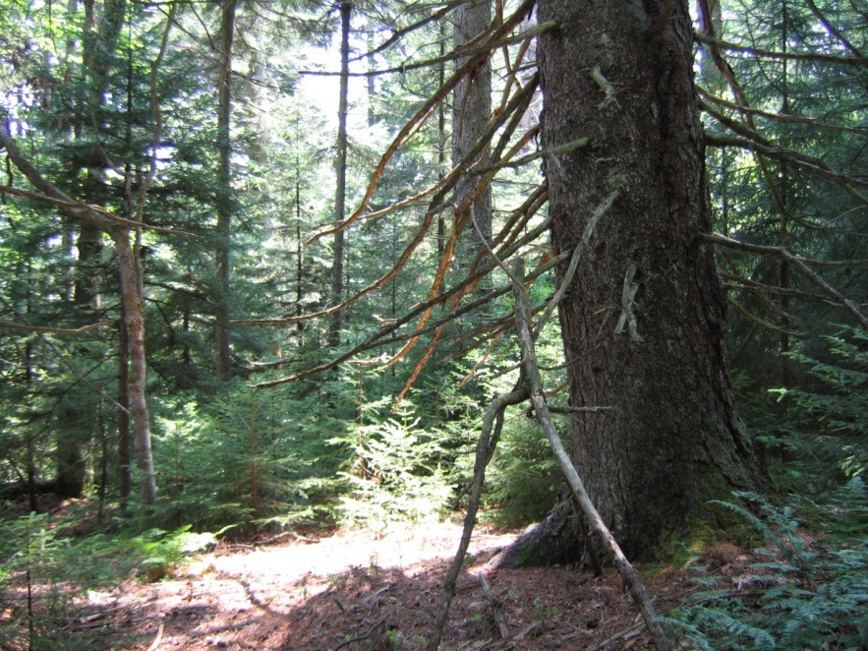
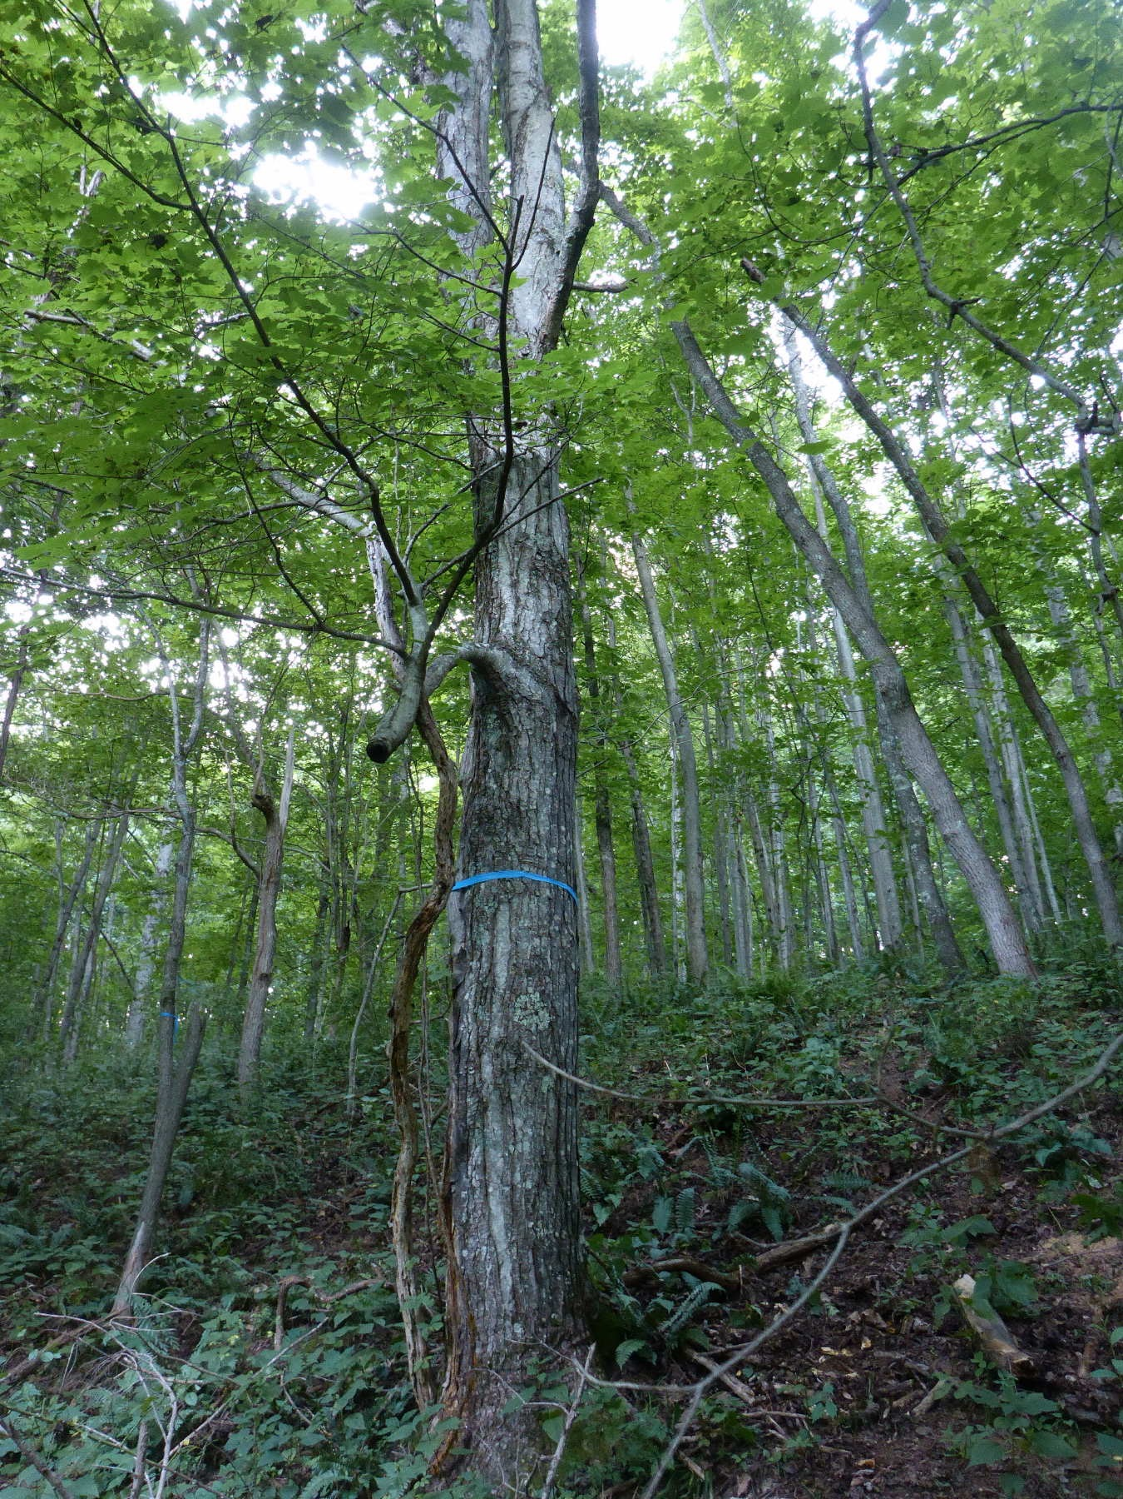
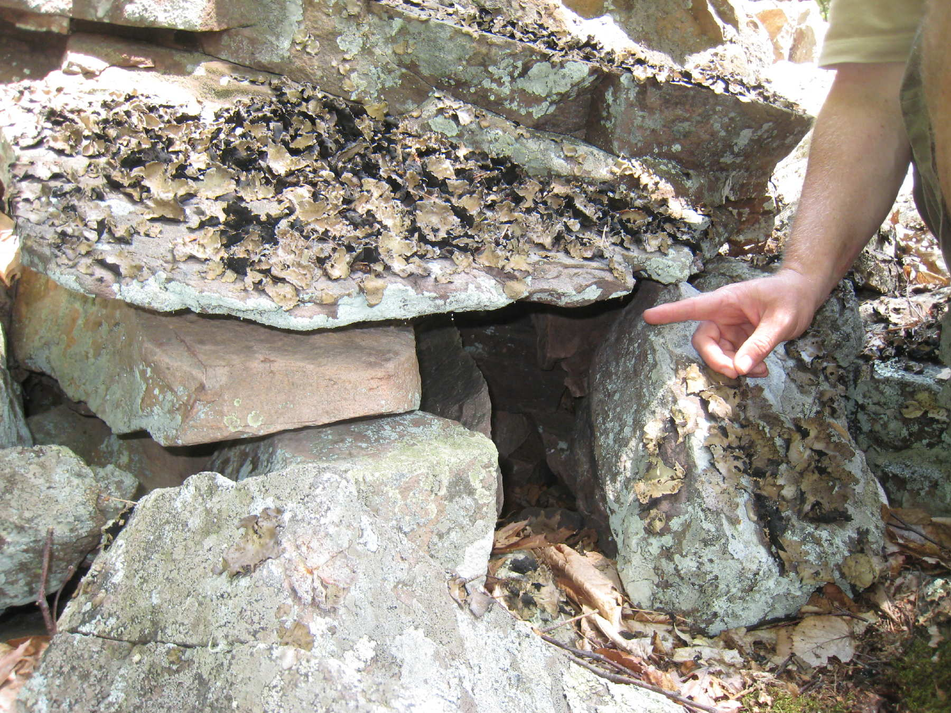
WV Habitat Examples
Notes:
While it is uncommon that that you will see threatened or endangered species. You need to be aware of any unique habitats. If you walk into an area and you can say to yourself “Wow this is a really nice stream” or “This is a really different area” – that’s something to take note of. If you see something really different or unique, you should be thinking of threatened or endangered species.

Slide 35
Invasive Exotic Species
Notes:
Many of you are familiar with the devastating effects of invasive forest insects in WV’s forests. There are also invasive plant species as well that are impacting WV’s forests.
While control of these species is possible and effective on a small scale, large scale control can prove more challenging. It is best to use some basic measures to minimize the spread of these species. Some of these measures include:
Clean all equipment – skidders, dozers, trucks, tires when moving from one location to another - know where your equipment has been.
Know your landscape – are there seed sources nearby? (some seed will disperse 200 m or thousands of meters, especially if dispersed by birds)
Know how your native species are likely to respond to each management type (shelterwood harvest vs. clearcut vs. fire vs. selection cut etc.). Do you have a healthy seed/sprout bank that is likely to recover quickly? Or will the disturbance require outside seed, allowing time for invasives to colonize the area first?
If deer are a known problem, fencing is advised to increase likelihood of native species regeneration.
Include forested buffers around harvests; strategically locate harvests across your landscape.
Timing – be willing to delay harvests until an invasion is under control.

Slide 36
Invasive Exotic Species
Approximately 2,500 species of plants known to occur in WV
  72% native | 28% introduced
Most introduced species never stray far
Some become very invasive and displace native plants in woodlands, wetlands, and other natural areas.
Notes:
Of the approximately 2,500 species of plants known to occur in the wild in West Virginia, about 72 percent are native or occurred in West Virginia before the time of substantial European settlement.
The other 28 percent, over 700 species, are not native to West Virginia, having been introduced from other states or countries.
Non-native plants have been introduced for erosion control, horticulture, forage crops, medicinal use, and wildlife foods.
They have also been introduced simply by accident.
Most of these species never stray far from where they are introduced (gardens, urban areas, agricultural fields), yet some become very invasive and displace native plants in woodlands, wetlands, and other natural areas.
These non-native invasive species are one of the greatest threats to the natural ecosystems of West Virginia.

Slide 37
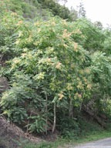
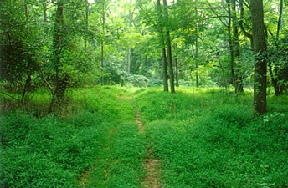
Invasive Exotic BMPs
Learn to identify invasive plants
Know if there are nearby seed sources
Clean all equipment
Minimize soil disturbance
Maintain forest buffers of competitive desirable species
Time harvests to minimize spread
Notes:
Once established, invasive exotic species are difficult to eliminate. By following these BMPs the damage of invasive species can be minimized:
Learn to identify invasive plants – there are handouts here today and also many available on-line
Know if there are nearby seed sources – seed can be dispersed a long way, especially by birds
Clean all equipment – washing seed and dirt when moving equipment from one location to another can prevent the introduction of invasives into uninfested areas; also clean boots, trucks and tires.
Minimize soil disturbance – invasives often prefer disturbed ground – don’t disturb soil unless it is necessary
Maintain forest buffers of competitive desirable species – these areas along roadsides and disturbed areas can prevent or slow the establishment of invasives
Time harvests to minimize spread – possibly delay harvests until the invasion is under control

Slide 38
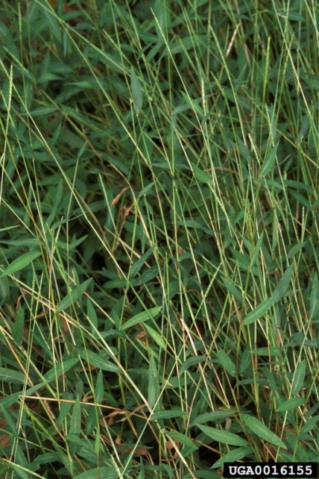
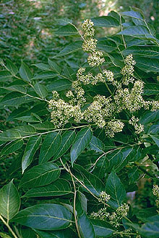
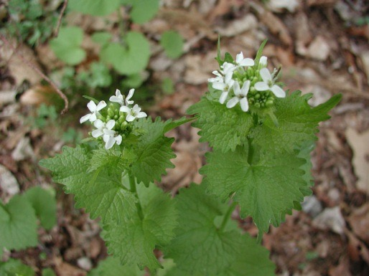
Can you name these invasive plants?
3
1
2

Slide 39
Tree of Heaven
(Ailanthus spp.)
Japanese Stiltgrass
3
1
2
Garlic Mustard
Notes:
There are many exotic plants that have invaded WV’s forests. The three highlighted today - Japanese Stiltgrass, Garlic Mustard and Tree of Heaven – are ones that have been identified to pose the most immediate threat. All three of these are damaging because of their ability to rapidly grow and spread throughout the understory and prevent the growth and establishment of regeneration of native tree species (I.e., oak, maples, cherry, walnut, poplar).

Slide 40
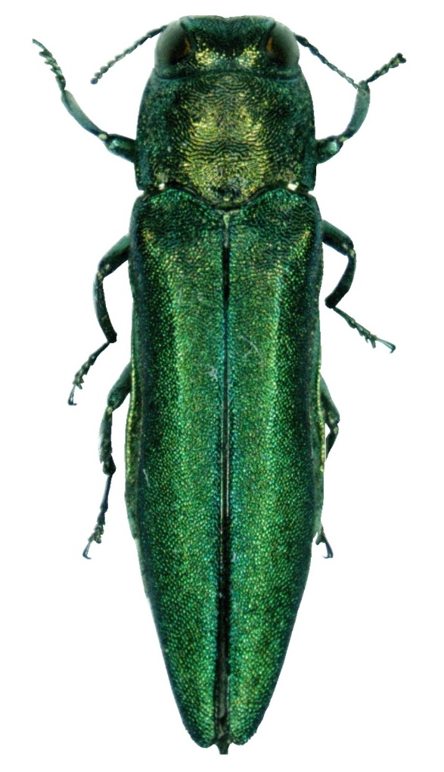
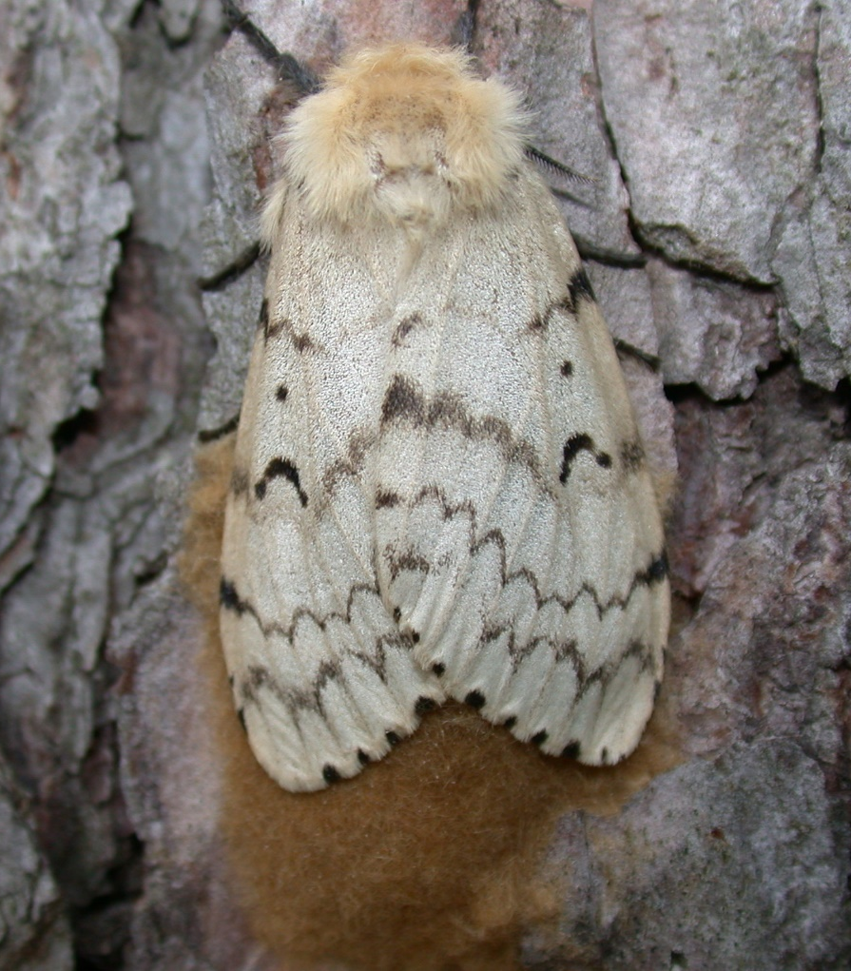
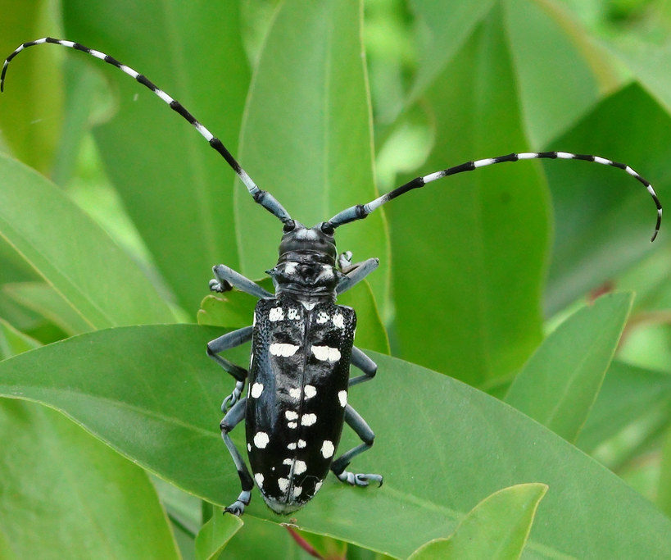
Can you name these invasive pests?
1
2
3

Slide 41
Can you name these invasive pests?
1
2
3
Emerald Ash Borer
Spongy Moth (gypsy moth)
Asian Longhorned Beetle

Slide 42
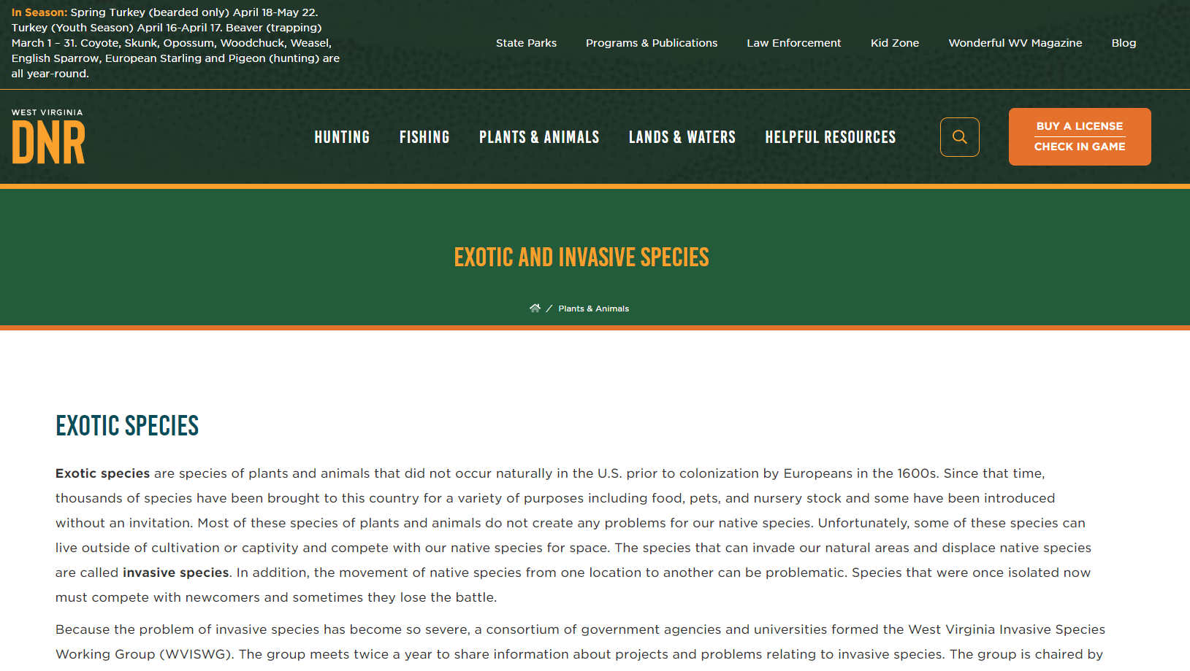
Invasive Species Resources
http://www.wvdnr.gov/wildlife/invasivespecies.shtm
Notes:
Where to go for help.

Slide 43
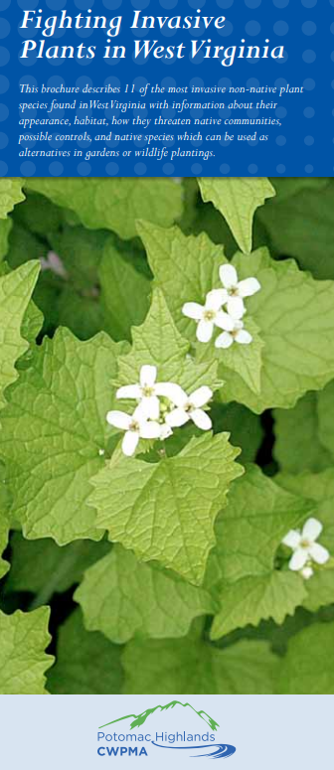
Fighting Invasive Plants in WV
Brochure describes 11 of the most invasive non-native plant species found in West Virginia
Information about their appearance, habitat, how they threaten native communities, possible controls, and native species alternatives for gardens or wildlife plantings
WV Native Plant Society
  https://www.wvnps.org/invasive-species

Slide 44
Indicator 4:
Logging Safety

Slide 45
Indicator 5:
U.S. Occupational Safety and Health Administration (OSHA) regulations, wage and hour rules, and other state, and local employment laws

Slide 46
OSHA
The Occupational Safety and Health Administration works to reduce workplace injuries and fatalities through training and safety standards.
Standards require employers to train works on hazards they may come into contact with
OSHA inspections are examinations of the worksite – typically done without notice
Penalties can easily range from a few thousand dollars to hundreds of thousands of dollars or even more.

Slide 47
OSHA Regulations Specific to Logging
Personal protective equipment
First-aid kits
Seat belts
Fire extinguishers
Environmental conditions
Work areas
Signaling and signal equipment
Overhead electric lines
Flammable and combustible liquids
Explosives and blasting agents
Hand and portable powered tools
Machines
Vehicles
Tree harvesting

Slide 48
Logging eTool
Example of a Generic Safety and Health Program for Logging
  Logging Contractor's Work Rules
  Logging Contractor's Hazard Communications Program
  Lockout/Tag Out Procedure
  Logging Contractor's Safety and Health Program
  Bloodborne Pathogens Exposure Control Plan
  Logging Contractor's Safety and Health Plan Outline

Slide 49
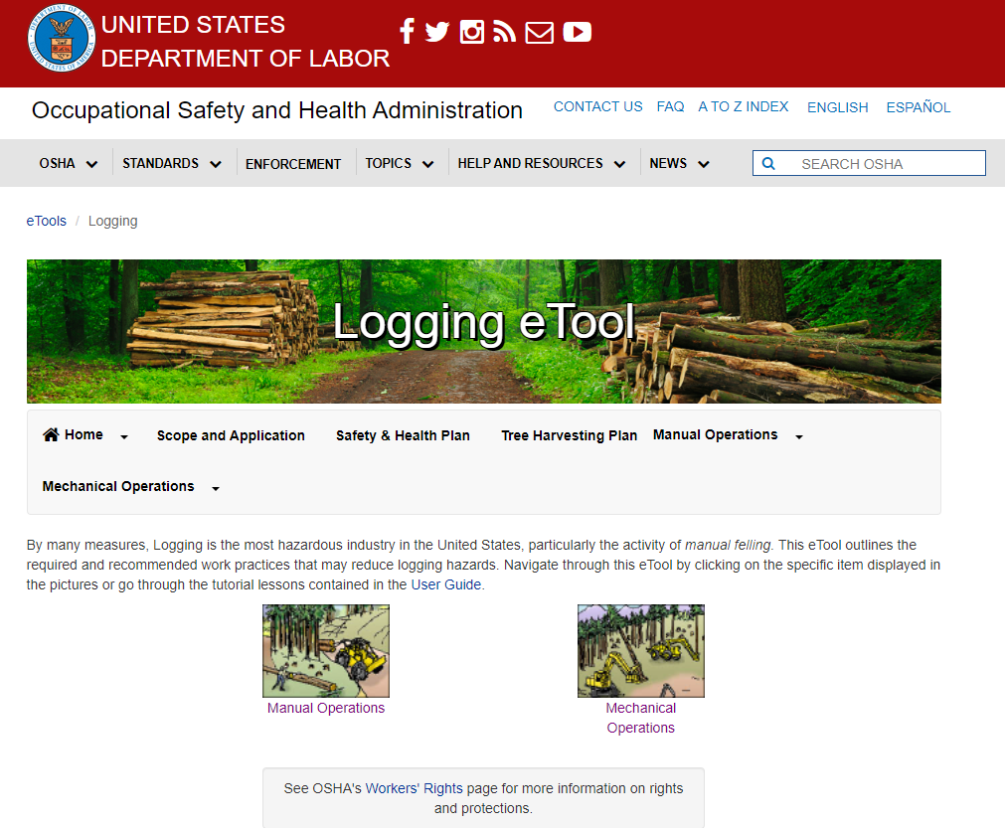

Slide 50
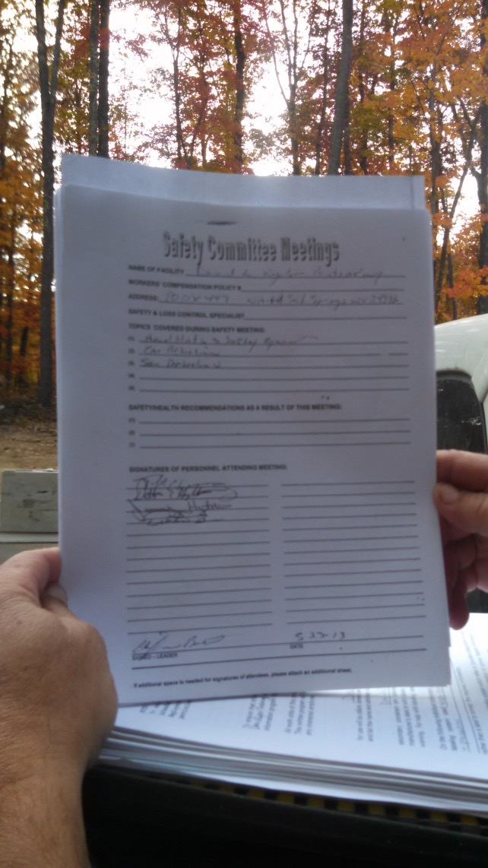
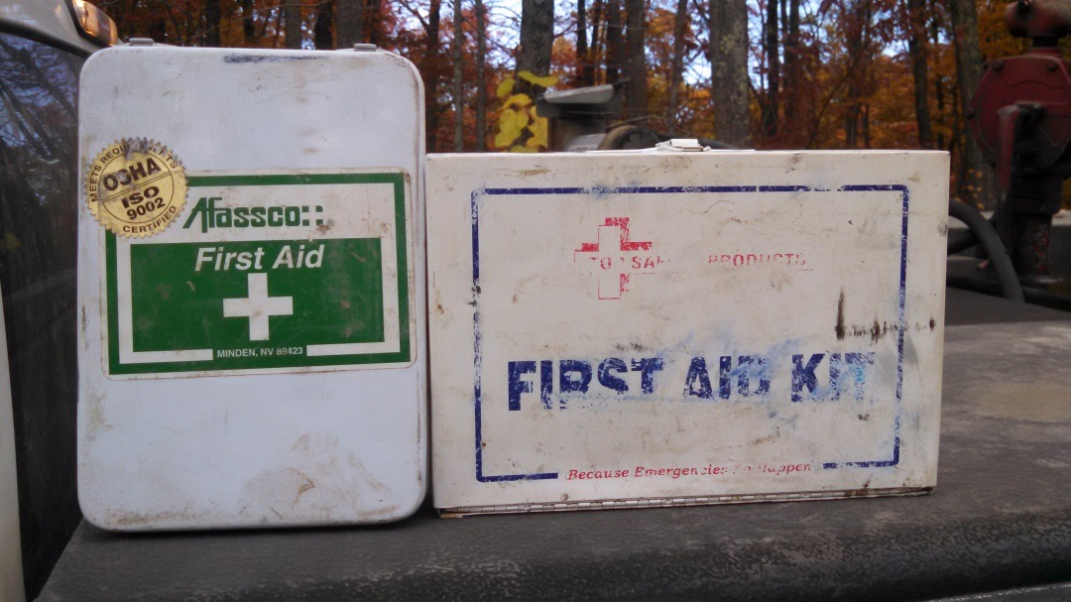
Safety
Always use and require others to use functioning PPE
Ensure vehicles have functioning required equipment
Safety talks are required – Always document!
First Aid kits are required
  At each work site where trees are being cut
  At each active landing
  On each employee transport vehicle
Notes:
On more serious note.
First Aid kits are very important to have on your job. Be sure everyone knows where it is and that it is fully stocked.
Safety talks are required and should be documented. A quick safety talk could be done informally each day. Remind everyone of the current conditions, hot, icy, cold, dead trees.
This web site is a great source of safety information for your organization.

Slide 51
OSHA First Aid Kit Requirements
Gauze pads (at least 4 x 4 inches).
Two large gauze pads (at least 8 x 10 inches).
Box adhesive bandages.
One package gauze roller bandage at least 2 inches wide.
Two triangular bandages.
Wound cleaning agent such as sealed moistened towelettes.
Scissors.
At least one blanket.
Tweezers.
Adhesive tape.
Latex gloves.
Resuscitation equipment such as resuscitation bag, airway, or pocket mask.
Two elastic wraps.
Splint.
Directions for requesting emergency assistance.

Slide 52
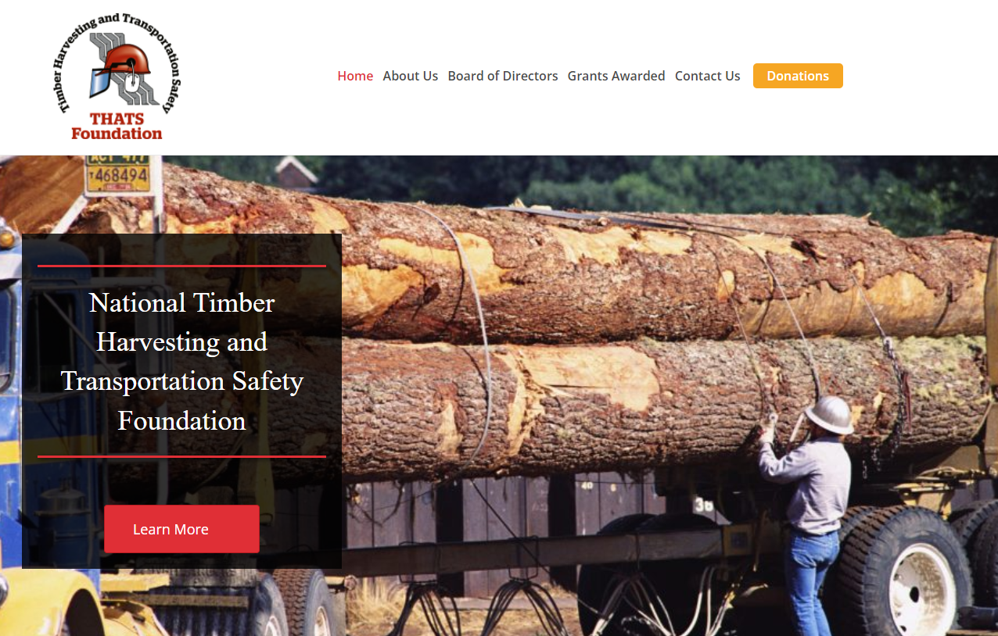
loggingsafety.com

Slide 53
Indicator 6:
Other topics identified by SIC that improve their responsibilities in meeting the SFI 2022 standards​

Slide 54
If you fail to plan then you should plan to fail!
Create a “Harvest Plan”
  Productivity
  Safety
  BMPs
  Customer satisfaction
  Public relations
  Business management
Incorporate knowledge from others
Document your plan so others may share the information.
Notes:
This is a good motto to consider.
Pre-planning is critical in aspects of your business. Your harvest plan details specifics related to each harvest that you can share with employees, foresters and others.
The harvest plan also serves as a document that others can use to reference information about the harvest in your absence.

Slide 55
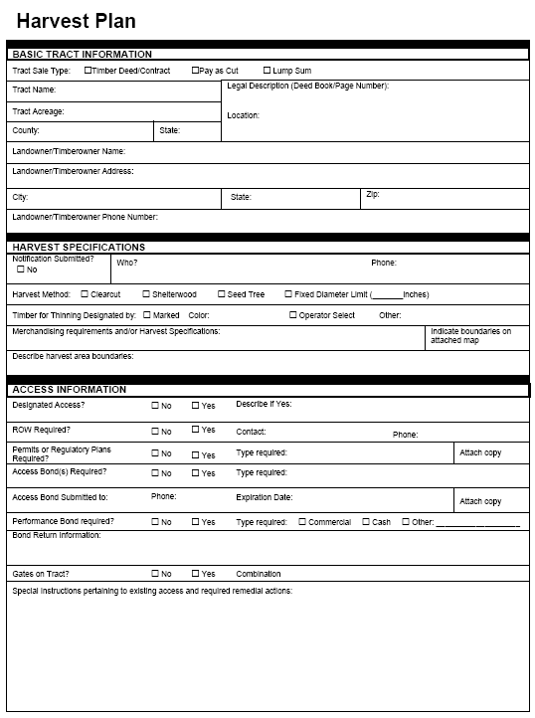
What is a Harvest Plan?
Basic tract information
Harvest Specifications
Access Information
Best Management Practices
Reclamation
Special Conditions and Requests
Notes:
A harvest plan completed at the beginning the job increases the overall success of the harvest operation. This was introduced in the last training , and we hope you will continue to use this tool to help you be successful.
A harvest plan is a tool that can be used to assist in job planning and also to document important information related to the harvest.
Pre-planning is key to the success of every job.

Slide 56
Be Aware of the Wage and Hour Rules
Career Training and Apprenticeships
Child Labor Statute & Rule
Employment Law Worker Classification Act
Jobs Act Statute & Rule
Minimum Wage & Maximum Hours Statute & Rule
Verifying Legal Employment Status Of Workers Statute & Rule
Wage Payment & Collection Statute & Rule

Slide 57
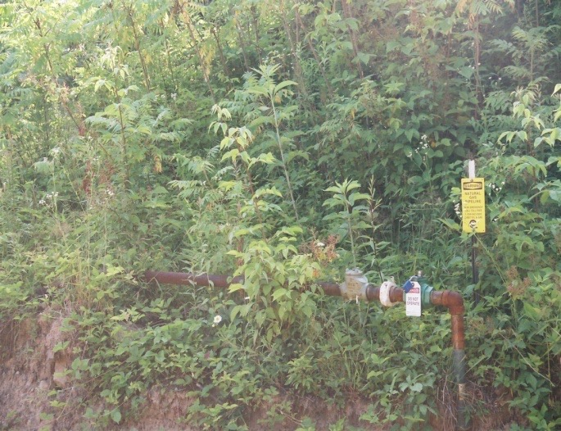
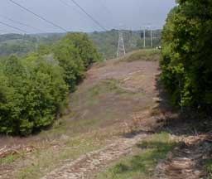
Utilities
Gas, electric and phone lines
Landowner’s well or spring box and waterlines
Contact and work with local utility companies
Call WV Miss Utility 811
Notes:
Call Miss Utility before beginning work. If they do not mark a line that turns out to be there, liability issue for you is minimized.

Slide 58
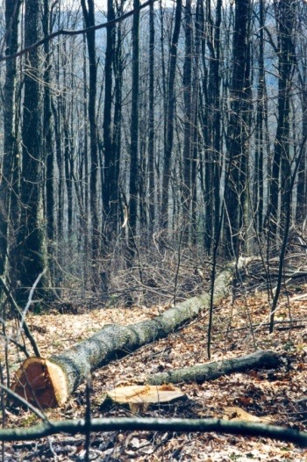
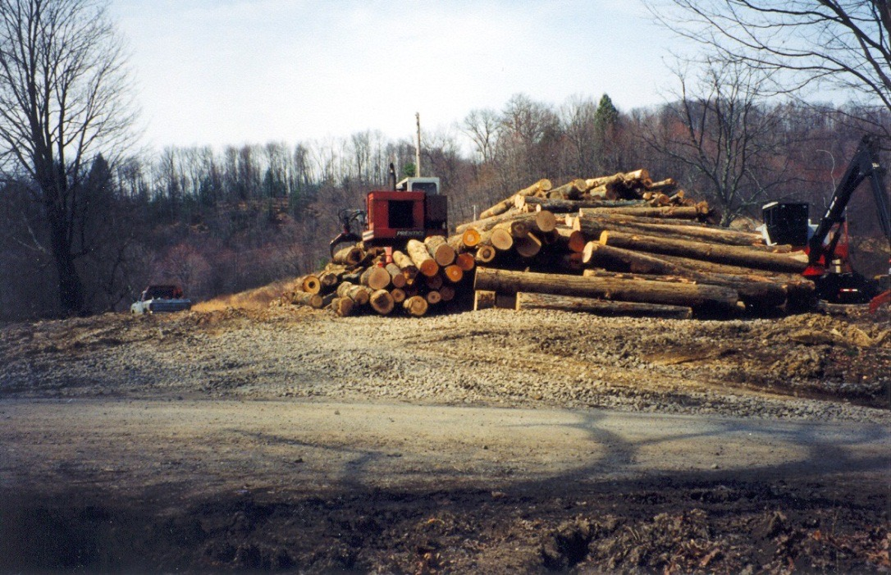
Merchandising
Include in your plan so all crew members are aware of the cut and merchandising requirements.
Notes:
Items for possible discussion:
Stump diameters (ex. Yellow-poplar to 14”; others to 18”)
Top end diameters (ex. )
Clear face requirements (ex. )
Minimum and maximum lengths (ex. Hard maple veneer to 20’;
others cut to 10’)

Slide 59
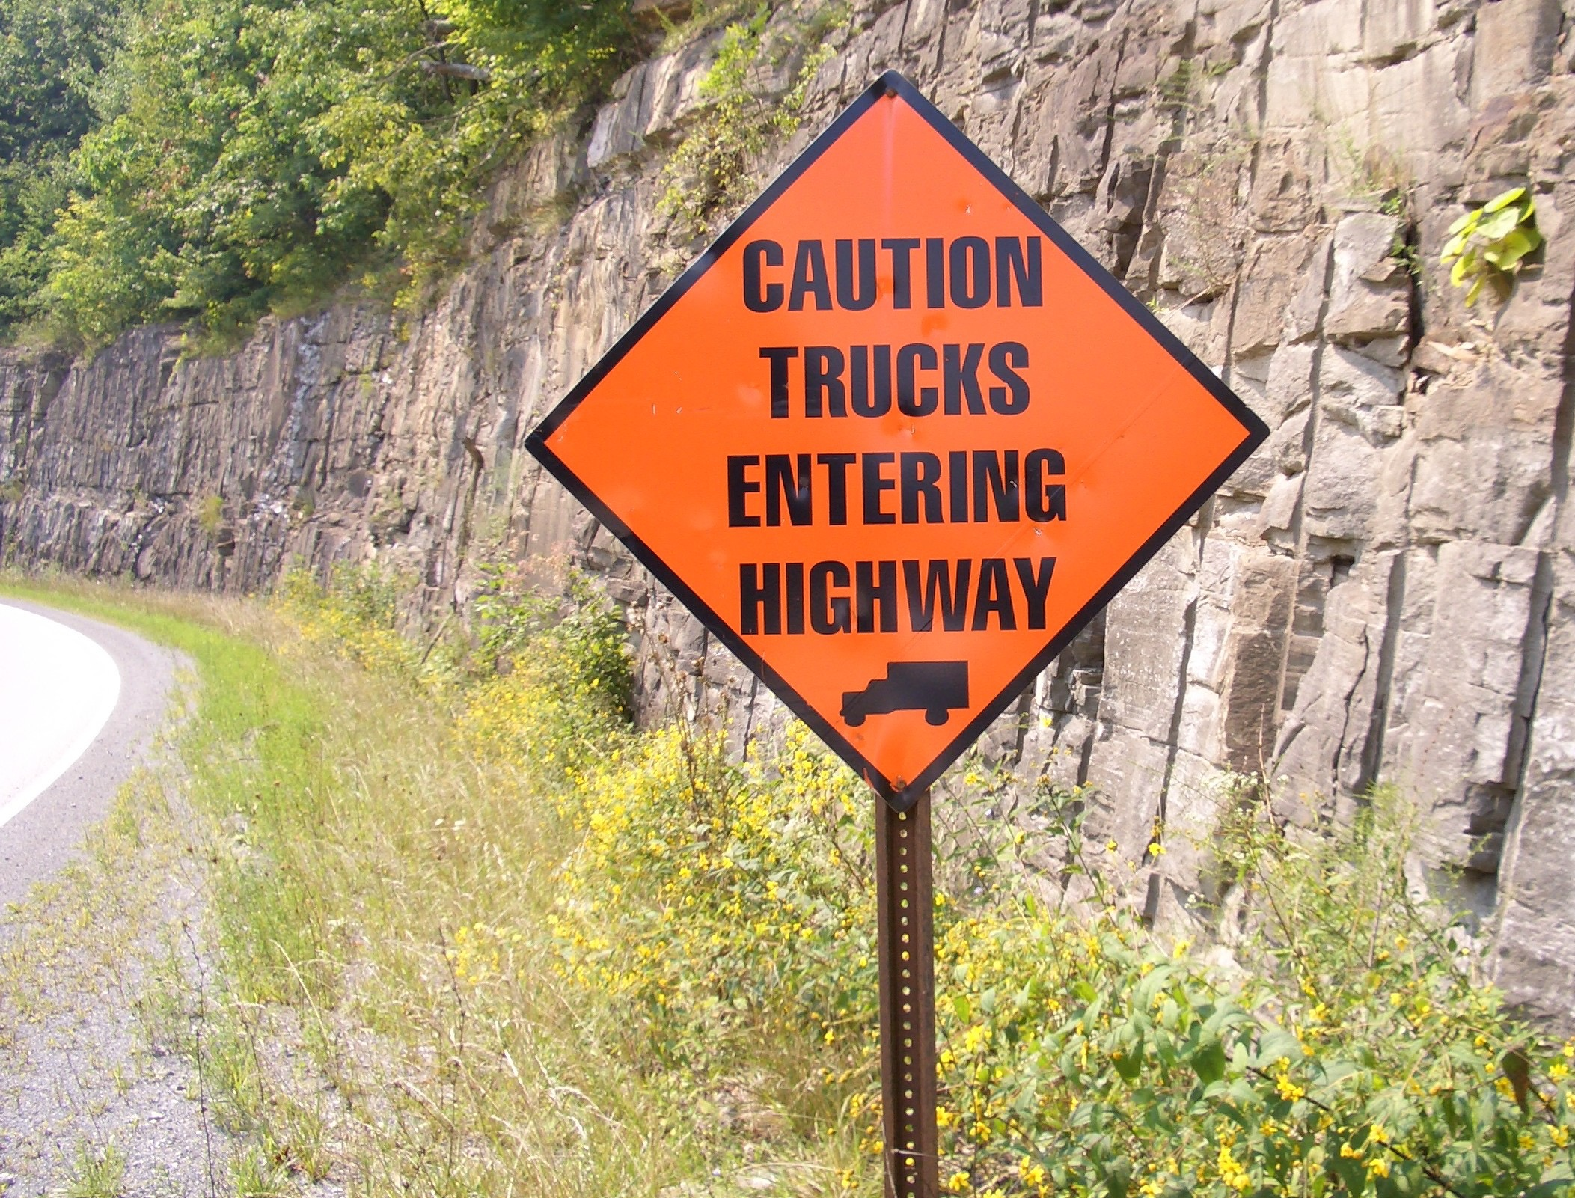
Site Access
Ensure adequate visibility at the entrance of your haul road
Keep public road free of gravel and mud at the job entrance
You are required to obtain an Entrance Permit from WV DOH
Notes:
Also discuss safe stopping distance at haul road entrance; if you have an entrance permit, follow the instructions on it. In Virginia, flagmen may be required.

Slide 60
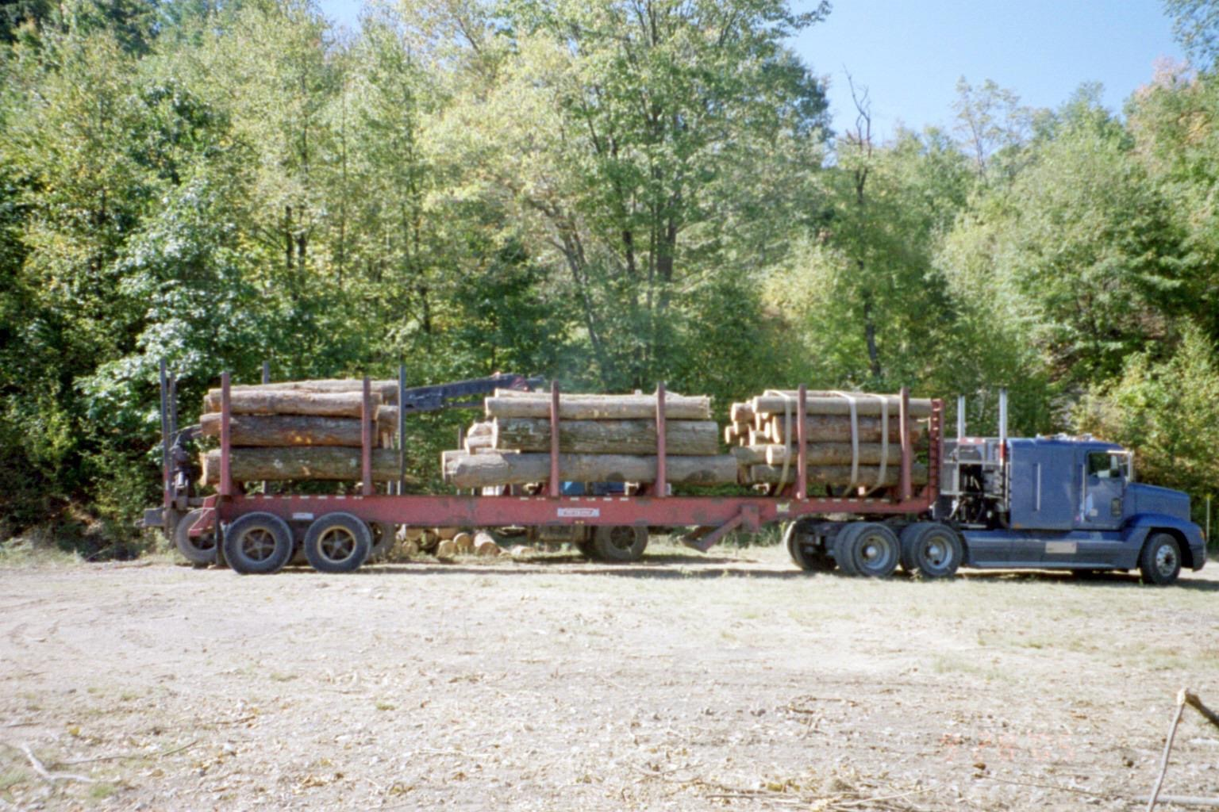
Trucking Safety
Properly load and bind your logs for transportation
Conduct pre-trip inspections daily and before truck is started
Notes:
An inspection of the log truck should be done prior to start up.
Mention binder spacing, load height, weights, lengths, bark and limbs hanging off truck Binders should be tight and properly spaced. Federal law requires 2 ties per bunk of logs; ties should be spaced to provide effective securement (no specific spacing length required).
The load should be balanced and stable and NO logs should be loaded above the standards.
A safe looking truck, usually is. A safe, clean and tidy appearance is a cheap advertisement of the ENTIRE forest industry.
Cleaning off truck after unloading! Significant liability issues regarding debris flying off of a truck and contributing to accident.
Mention truck safety days: All participating trucks will receive a voluntary Class 1 inspection on their truck and/or trailer. If successful, Commercial Vehicle Safety Alliance (CVSA) sticker will be awarded. This sticker exempts the driver from regular roadside safety inspection for three months (end of December). Food and safety items are presented to all participants at no charge. A mechanic is on-site to perform any needed repairs – driver is only charged for the cost of the parts. Any questions, contact the WVFA Office.

Slide 61
Petroleum Spills
Fuel storage tanks should be located away from water sources and the use of earthen dikes around tanks may be needed.
Each job should have a spill clean up kit on site.
In WV all spills, particularly those that cause a “sheen” or film on water or shore line, must be reported.
Call WV DEP at 800-642-3074
Notes:
This is correct. The Law indicates any spill should be reported. The old 25 gallons was a judgment call someone made in the past.

Slide 62
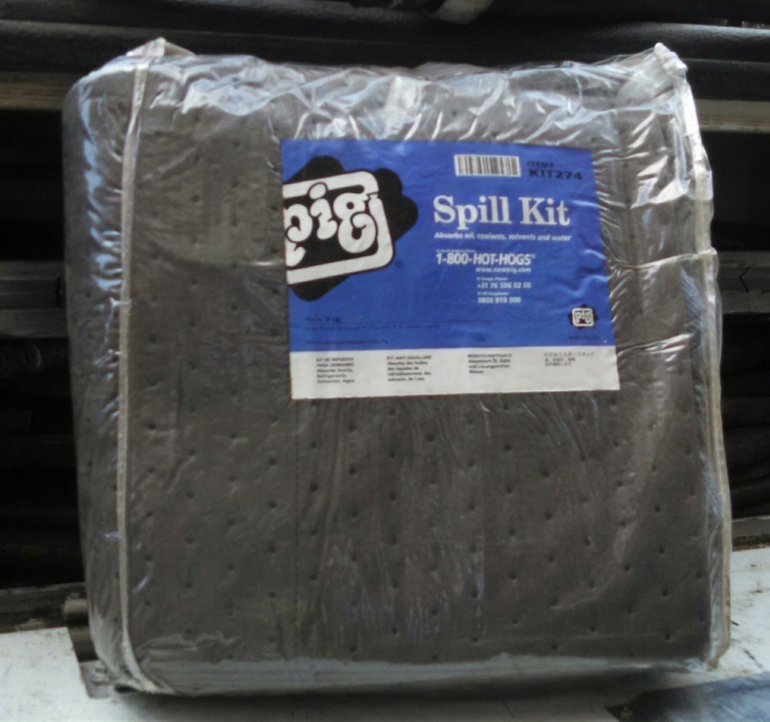
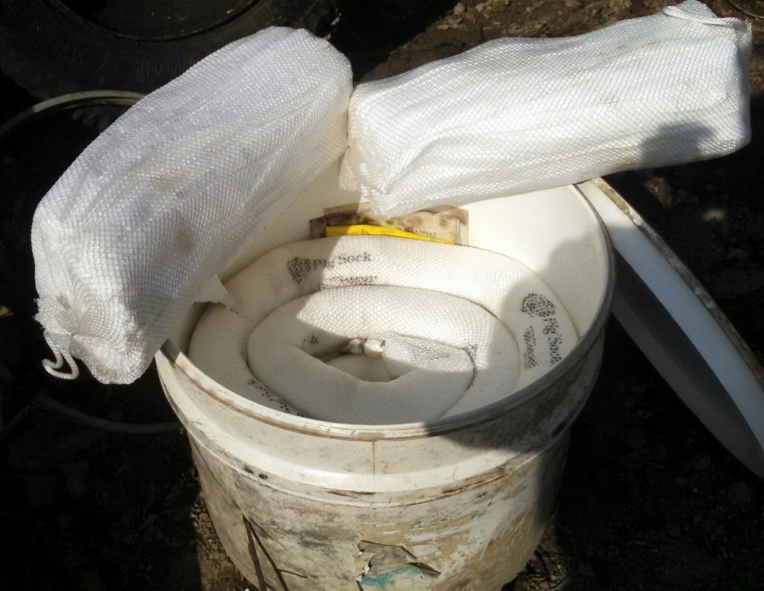
Petroleum Spills
Awareness, Prevention, Clean Up
Notes:
How many people have a Spill Kit on their job?
Spill kits are relatively inexpensive, are required by certification standards and very helpful after a spill.
http://www.newpig.com/pig/US/spill-kits-1673
http://www.grainger.com/ about $43

Slide 63
Forest Aesthetics
How the Forest Looks

Slide 64
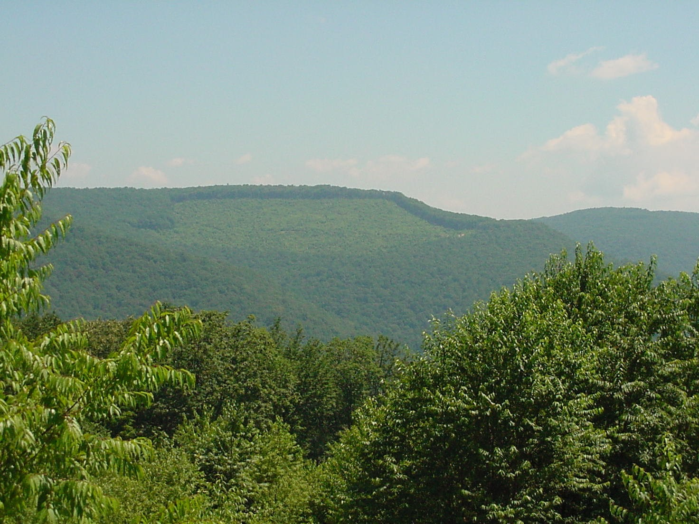
Aesthetics
Using forestry practices to improve the looks of a harvesting operation
Notes:
Attendees need to know this definition for forestry aesthetics.
Very important in visually sensitive areas

Slide 65
Aesthetics-Topics for Discussion
Aesthetic Management Zones (AMZ) – visually sensitive areas that should be managed to minimize visual impact.
Proper road layout is important to minimizing the visual impact of a job.
Don’t spare the grass seed around landings, haul roads and stream crossings.
Feather edges of the cut and strategically select leave trees.
Harvest buffers when leaves are off.
Notes:
Aesthetic Management Zones (AMZs) are areas in visually sensitive areas where various techniques may be used to minimize the visual impact of the harvest (ex. Buffers, feathered edges, etc.)
Harvest Areas - Avoid straight boundary lines on that make the operation more noticeable to the public. Feathering edges and strategic placement of leave trees are just becoming common in planning a harvest
A trashy looking landing gives the impression of someone who has not respect for the land – be courteous!
Extra grass seed and mulching in areas where it may not necessarily be required, can go a long way towards good PR.

Slide 66
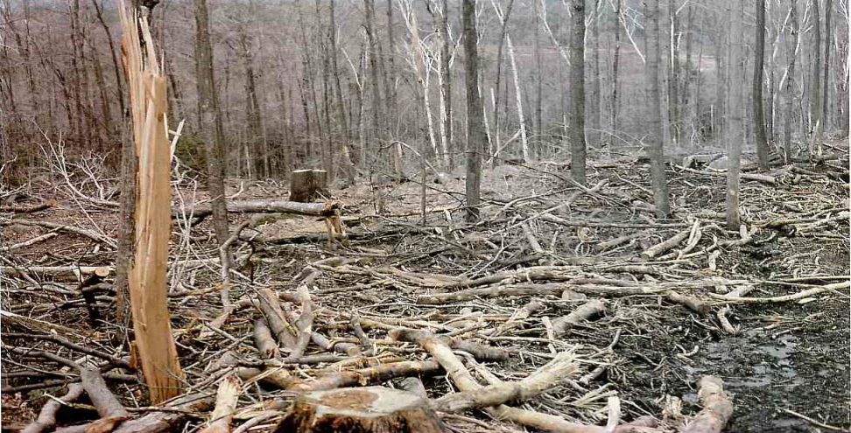
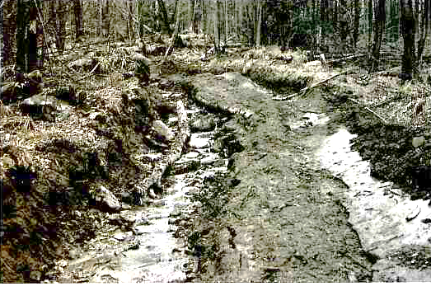
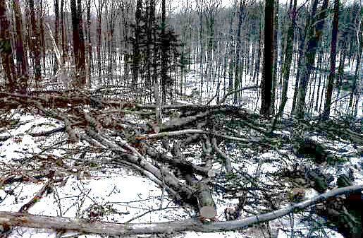
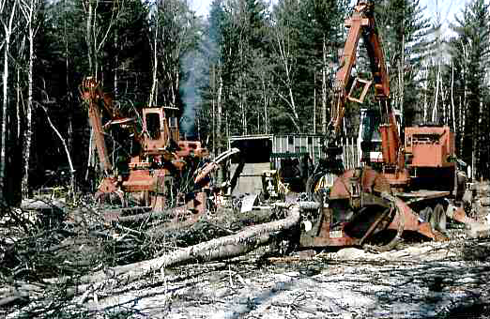
Logging is Disruptive even under the best conditions, but it does not have to be destructive or “look bad”.
Notes:
Logging can be a little messy. We all know this, but we know how things will recover. Remember most people that will criticize your operation does not realize how well the area will recover. Think about a logging job like an operation in a hospital. If you walk in in the middle of the operation it will look messy. The doctors have best management practices to keep the area sterile and safe, just like we have BMP’s for Forestry. Right after the operation the patient may look a little rough, but in time will heal and be better than before. We need to be sensitive to the way our jobs look to the public.

Slide 67
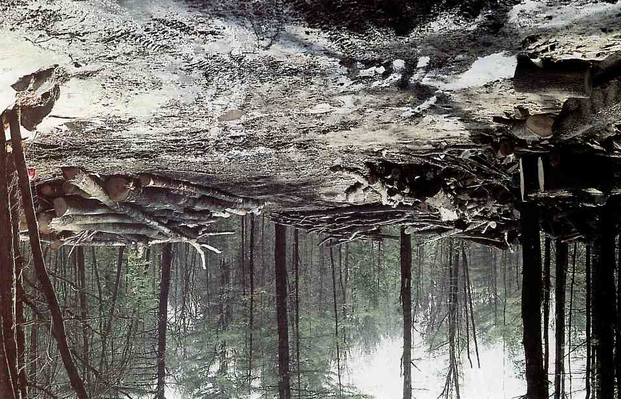

Ease concerns with pictures and discuss the recovery process
Notes:
Landowner Concerns.
Destroy Natural Beauty
Destroy Recreational Opportunities
Destroy Aesthetic value
What about the wild life?

Slide 68
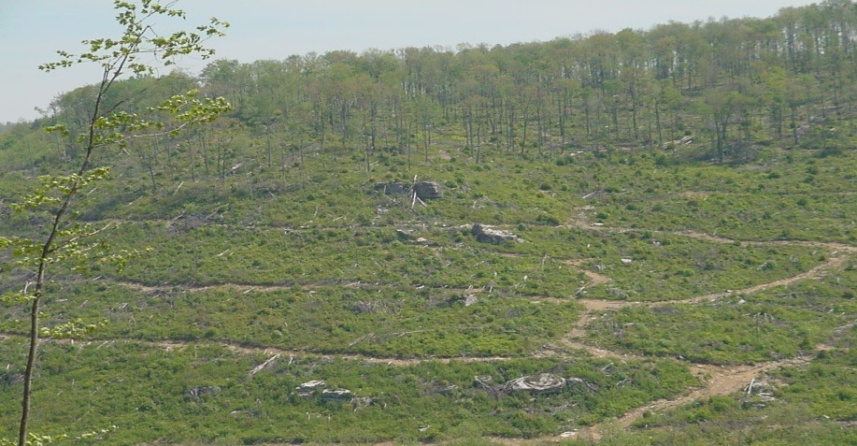
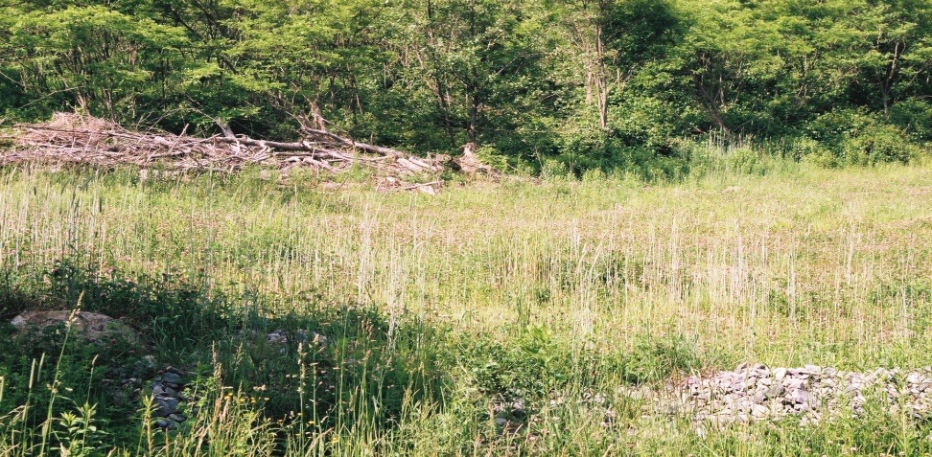
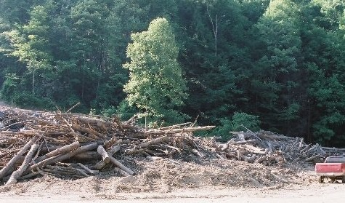
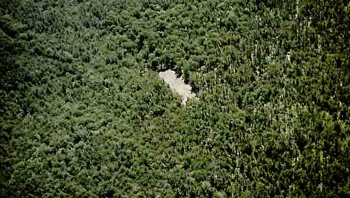
A little planning goes a long way

Slide 69
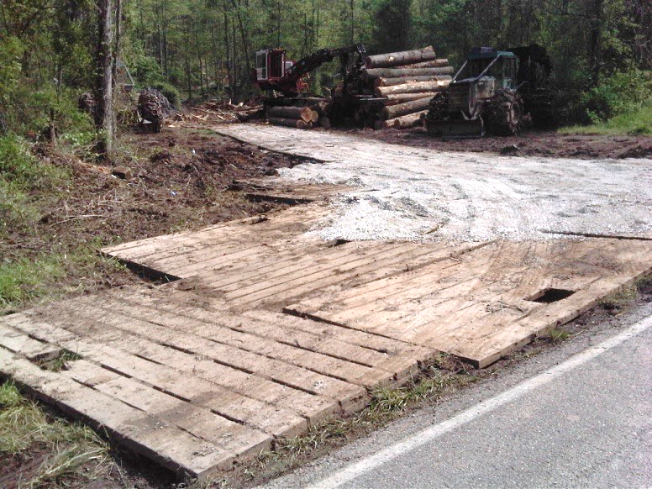
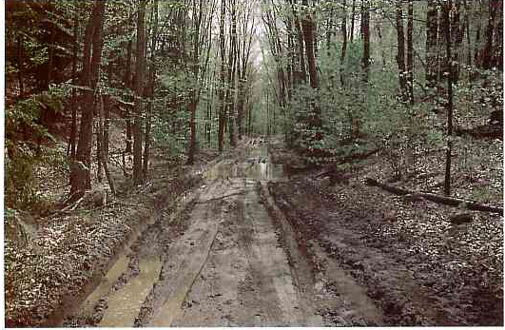

Road Access
Geotextile Mat then Stone
Wooden Mats

Slide 70
Emerging Technology
New Technology is very important for any industry.
Technology in our industry often moves slow.
Always be on the look out for new issues, they may be the next big thing that will help your business
Examples
  Saw bucks – How did you buck logs 20 years ago?
  Mapping Technology – onX, Avenza, etc
  GPS for mapping and line location
  Harvesting systems – cable yarders, cable assisted harvesters
  Changes in diesel technology
  Machine communication/service systems
Notes:
Emerging Technology is very important, everyone should be on the look out for the next big thing in our area.
May be able to provide some additional examples on your own.
Harvesting Systems- Feller Bunchers are becoming increasing common in WV. In some areas, cable yards or cable assisted harvesters could become more important.

Slide 71
Inconsistent Practices by SFI Program Participants
Concerns/Complaints are received
via WVDOF or Toll Free Number
Concern/Complaints reviewed by
WVFA Exec. Dir
Non-water quality complaints and concerns referred to SFI Program Participants
Water quality complaints and concerns referred to WVDOF
WVDOF determines if complaint is valid and issues CO/SO/ or legal action
CO/SO that are on SFI Program Participant land will have an SFI Inconsistent Practices Reporting Form submitted to WV SFI Forester
SFI Participant contacts and responds to concerned party within 5 working days of complaint and submit SFI Inconsistent Practices Reporting Form to WV SFI Forester
Satisfied – Report Progress to WVFA
Not Satisfied – Request arbitration board made up of non-SFI Program Participants; reviews complaint/concern and makes decision and recommendation. If unreconcilable, forward to SFI, Inc.

Slide 72
Loggers are a critical link in the supply chain.
What you do reflects on you, the landowner, the timber purchaser, and the forest industry.
Professional work helps all parts of forestry improve sustainable management, harvesting, and products for all of our futures.

Slide 73
For More Information:
Sustainable Forestry Initiative | forests.org
WV Forestry Association | wvfa.org/sfi

Slide 74
SFI True/False Test
T F Sustainable forestry is managing today’s forest resource needs in a way that does not compromise the ability of future generations to meet their forest resource needs.
T F In West Virginia, there are eight SFI Program Participants: Smurfit WestRock, Weyerhaeuser, Summit Bechtel Reserve – BSA, Conservation Fund, Pixelle Specialty Solutions, and Lyme Mountaineer Timberlands and the Colane Corporation
T F A harvest plan is not important to the overall success of the timber harvest and should not be completed until after the timber is harvested, if at all.
T F The SFI label is placed only on solid wood products, never on paper or packaging materials.
T F One way to minimize the spread of invasive species is to wash all equipment (i.e., skidders, dozers, trucks, tires) when moving from one location to another.
T F Japanese stilt grass rapidly grow and spread throughout the understory and prevent the growth and establishment of regeneration of native tree species
T F Proper road layout is an important part of forestry aesthetics.

Slide 75
T F The only petroleum spills that need to be reported are those that contaminate a major river.
T F The first SFI programs were started approximately 10 years ago.
T F It is not necessary to get entrance permits from the West Virginia Department of Highways for truck roads entering highways, because the roads are only temporary.
T F According to the Endangered Species Act, it’s okay to harm, harass or possess an endangered species, as long as you don’t kill it.
T F Forestry aesthetics is using forestry practices that improve the looks of a harvesting operation.
T F Penalties for violating the Endangered Species Act include fines of up to $200,000 for an organization and $100,000 for an individual, and/or one year in jail.
T F On site OSHA inspections are always pre-arranged with the logging company.
T F Project Learning Tree is one of SFI’s education programs for teachers and others working with youth from preschool through 12th grade.

